Slide 1
Networking and the internet
Lesson 3: Packets and packet switching

Slide 2
Objectives
In this lesson, you will learn:
how data is split into packets
why data is split into packets
what packet switching is
why packet switching is important.

Slide 3


Activity 3.1: Spider drawing
Take an A4 piece of paper and fill the page with a drawing of a spider.

Slide 4

Create packets
Fold your drawing in half and then in half again.
Use the fold lines to cut or tear your drawing into four equal-sized packets.

Slide 5
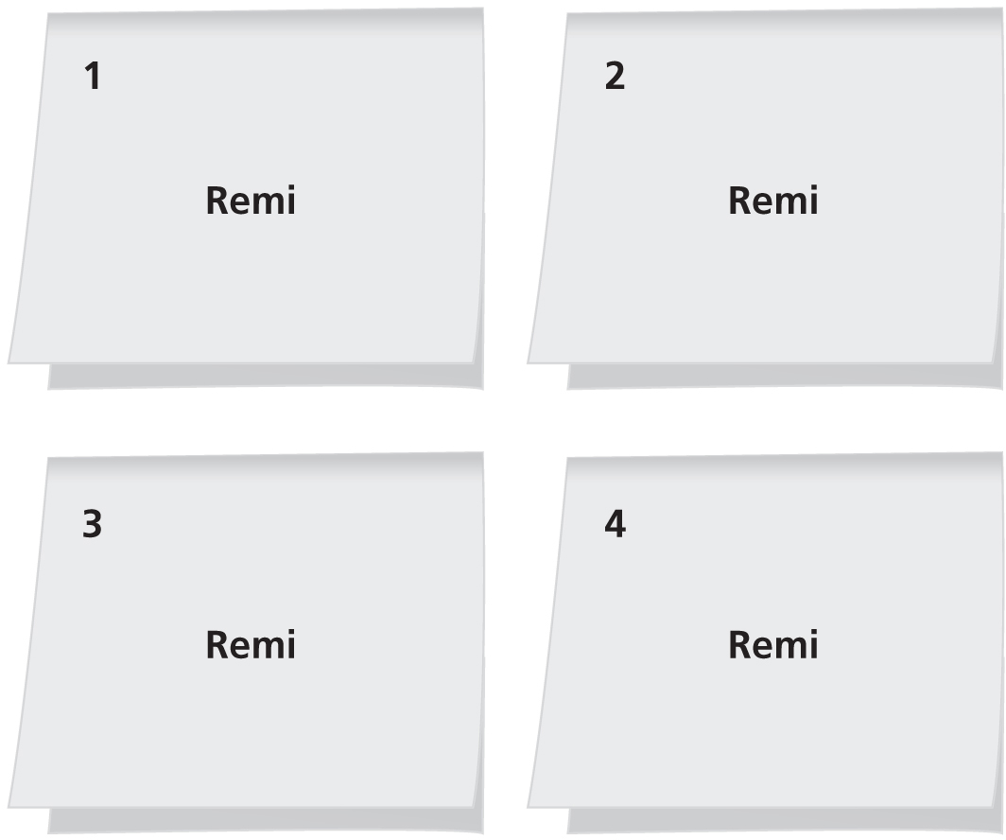
Label the packets
Fold each packet to hide its contents.
Number the packets from 1 to 4 on the outside.
Write the name of the intended recipient on the outside of all four packets.

Slide 6

Data transmission
Pass the packets to the intended recipient following these rules:
You must stay in your seat.
You must pass the packets, not throw them.
You can only pass one packet at a time.
You must pass the packet towards the recipient.
When you have received all four packets, open them, put them in order and check that the message looks OK.

Slide 7
Packets
A packet is a small chunk of data.
When a file or an email message is sent over a network, it is split into equal-sized packets.
Just like your spider drawing, each packet is numbered and addressed to the recipient.

Slide 8
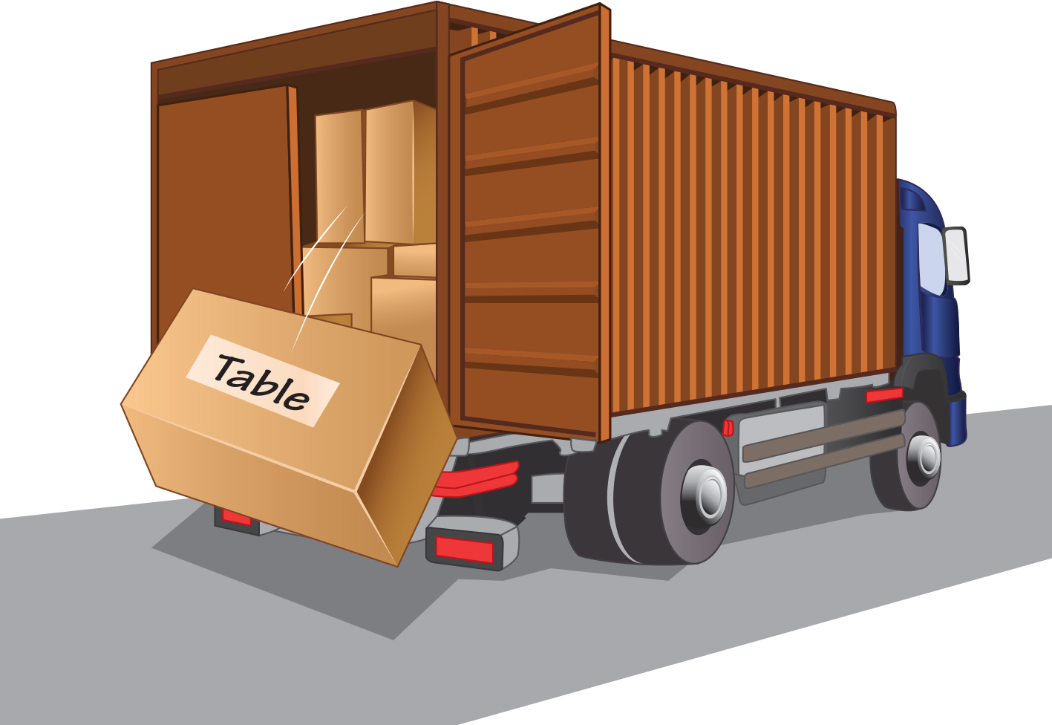
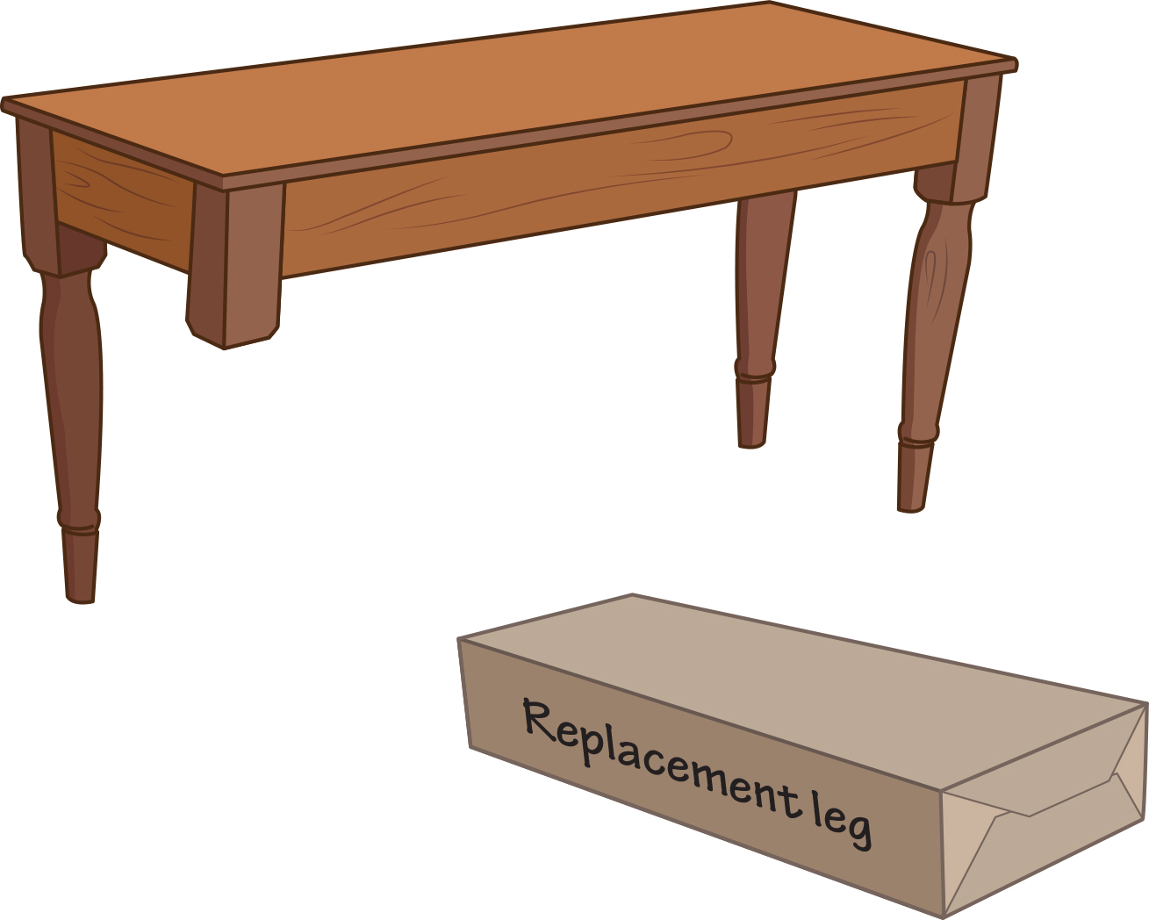
Advantage of packets
If a whole file or a whole email message goes missing or is damaged, then the whole file or the whole message has to be re-sent.
If a packet goes missing, or is damaged, then just one packet needs to be re-sent. Having the packet numbers makes it easy to identify which one is missing. This is much less work!

Slide 9
Disadvantage of packets
Each packet must have a header added to it which includes:
packet number
IP address of recipient
IP address of sender
Adding this data to every packet increases the total amount of data sent by about 3%.
Despite this disadvantage, using packets is better than sending files or emails in one go.

Slide 10
Activity 3.2 Packets
Complete Interactive 3.2

Slide 11
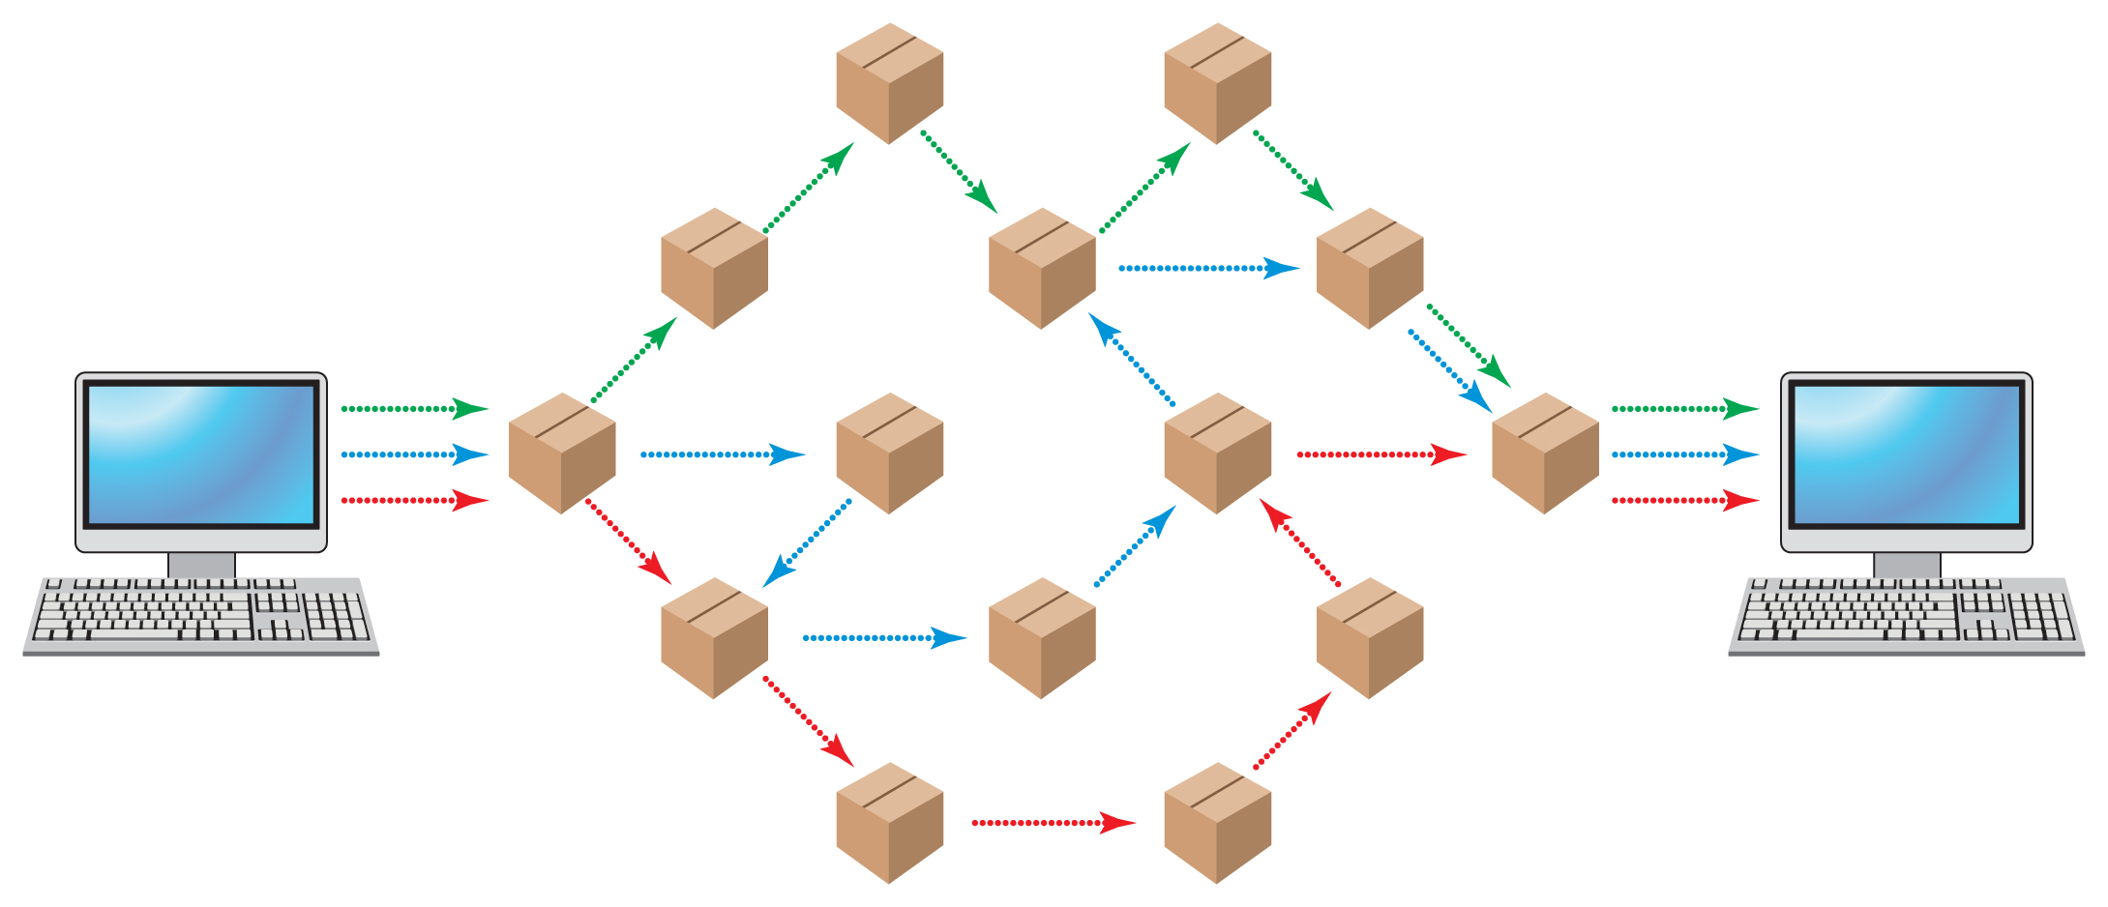
Packet switching
Each packet travels independently, like the parts of your spider drawing.
If there is a traffic jam, then different packets can take different routes.
Because each packet is numbered, it doesn’t matter if they arrive in the wrong order. They can be put into the correct order when they all arrive.
This is called packet switching.

Slide 12
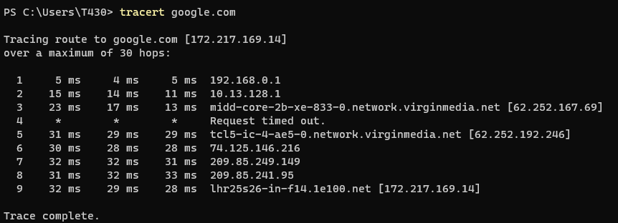
Traceroute
A traceroute shows you the hops a packet makes as it travels across the internet.
A starred hop is a hop that failed because it timed out. The packet then tried a different route.

Slide 13
Activity 3.3: Traceroute

Slide 14
Activity 3.4: Packet switching
Complete Interactive 3.4

Slide 15
Activity 3.5: Toppers (Part 3)

Slide 16
Quiz 3

